Slide 1
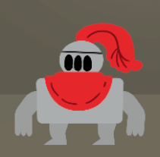
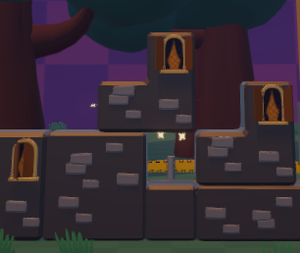
Tetrimination Pitch

Slide 2
Team
Bongaerts Yorick
Bull Andrés
Lefebre Elias
De Weert Erik
Olbrechts Baue

Slide 3
Trailer
Add trailer video

Slide 4
Game Overview
Party game
Tetris-like
Point system
Platforming
Strategy
Rounds of gameplay

Slide 5
Player Objective
Score points
Crushing, Imprisoning, Reaching new heights

Slide 6
Design Pillars
Cunning: Work together or not?
Take-That!: Backstabbing advised
Balancing: Keep track of abilities and use them wisely
Notes:
Zie design pillars in GDD

Slide 7
Unique Selling Points
Many ways to play
Tricking enemies
Resource management
Short party game
Notes:
Met many ways to play bedoel ik dan: FFA, 1v3, backstabbing
Resource management doelt op ability timers en ladders die kunnen breken

Slide 8
Important info
Aimed at Xbox One
Party context

Slide 9
Questions?

Slide 10
Thanks for listening

